Slide 1
Leveraging Big Data and Electronic Health Records to Create a Data Fluent Culture for Cancer Medicine
Mia Levy, MD, PhD
October 8, 2015
Komen Big Data for Breast Cancer

Slide 2
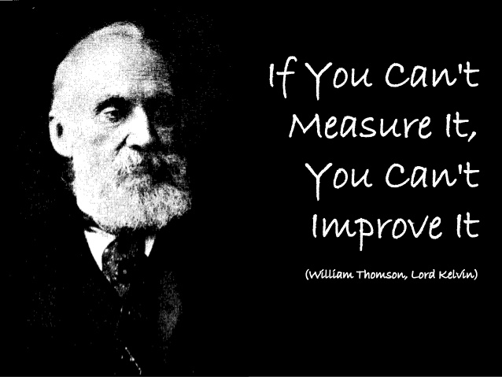

Slide 3
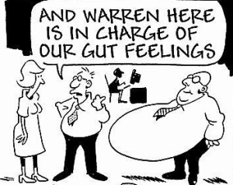

Slide 4
Data fluency: the ability to use the language of data to fluidly exchange and explore ideas within an organization
Gemignani, Gemignani, “Data Fluency: Empowering Your Organization with Effective Data Communication” 2014

Slide 5
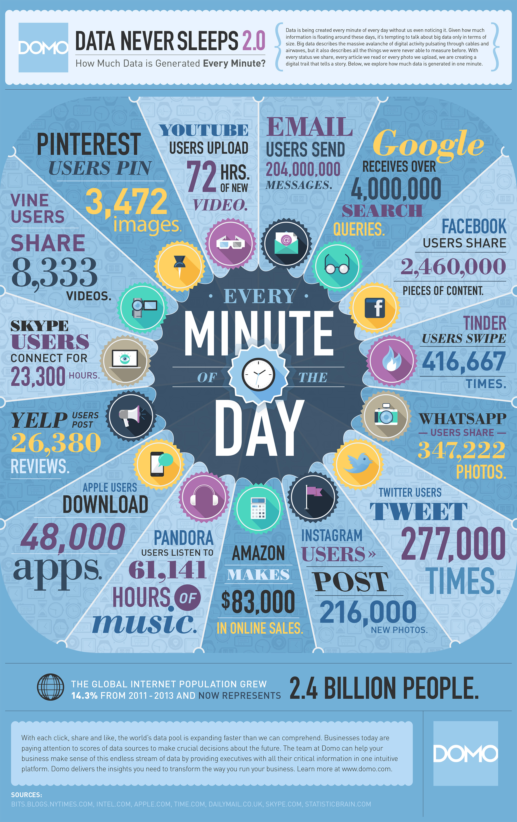
2.5 Quintrillion bytes of data are created everyday
90% of the data in the world today has been created in the last two years alone
-Big Data Beyond the Hype
Susan Genulius:
Data Never Sleeps
http://aci.info/2014/07/12/the-data-explosion-in-2014-minute-by-minute-infographic/

Slide 6
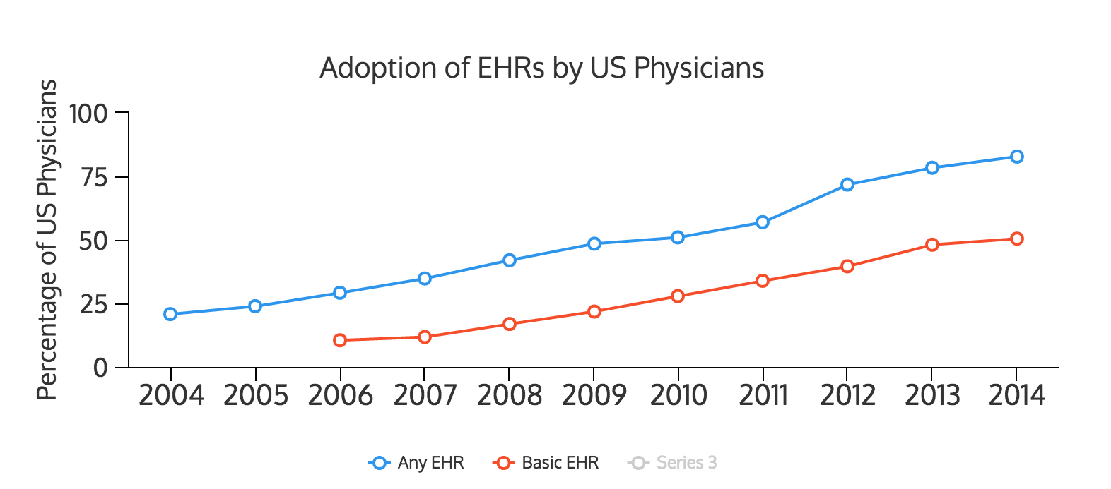
83% of US physicians have EHR System
Office of the National Coordinator:
http://dashboard.healthit.gov/quickstats/pages/physician-ehr-adoption-trends.php

Slide 7
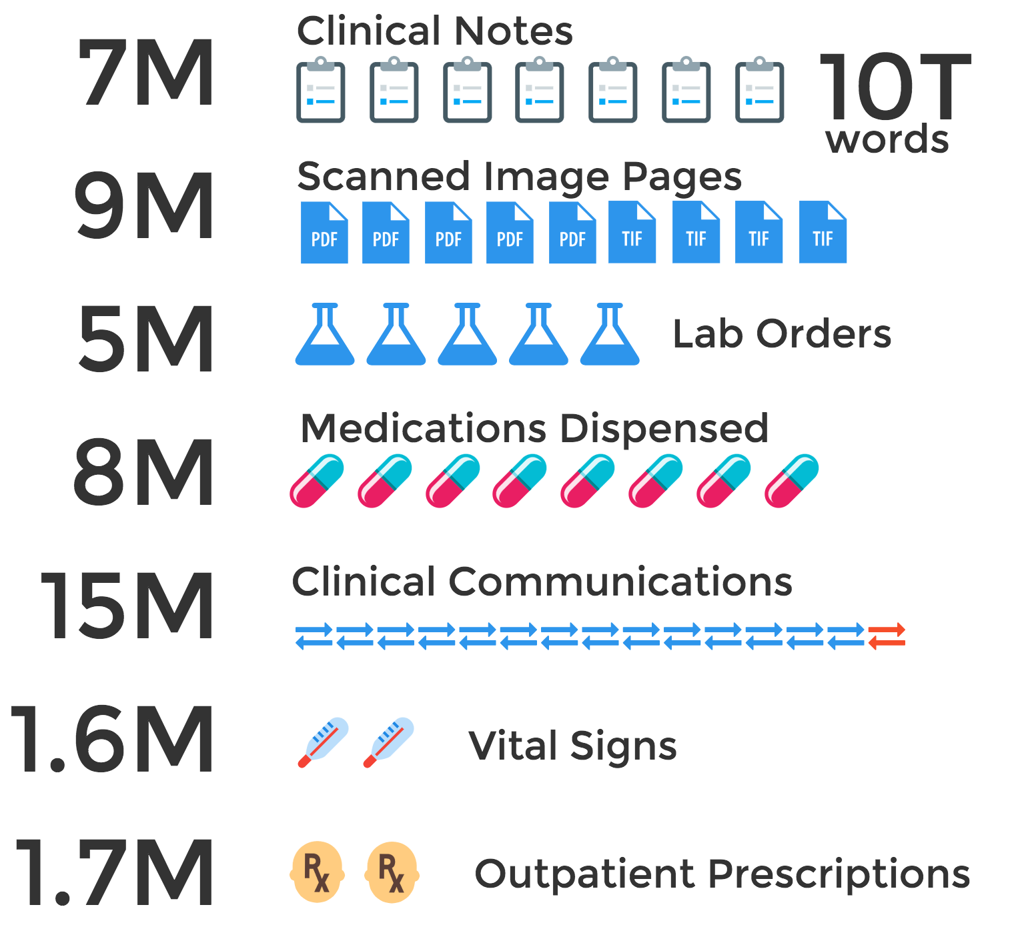
EHR Data Created
Each Year
at Vanderbilt
Notes:
Vanderbilt EHR statistics 2013
11K – people access system each day
437M page hits per year
6.8M clinical notes created per year
9.2M scanned image pages per year
1.6M vital signs recorded per year
2M problem list updates
186K immunizations recorded
13M inpatient orders
1.7M outpatient e-prescriptions
15M clinical communications
327K patients enrolled in patient portal, 484K patient-provider message threads per year
5.3M Lab tests ordered
825K Radiology studies performed per year
8.1M Meds Processed in Pharmacy System per year
190M nursing documentation elements
Billing

Slide 8
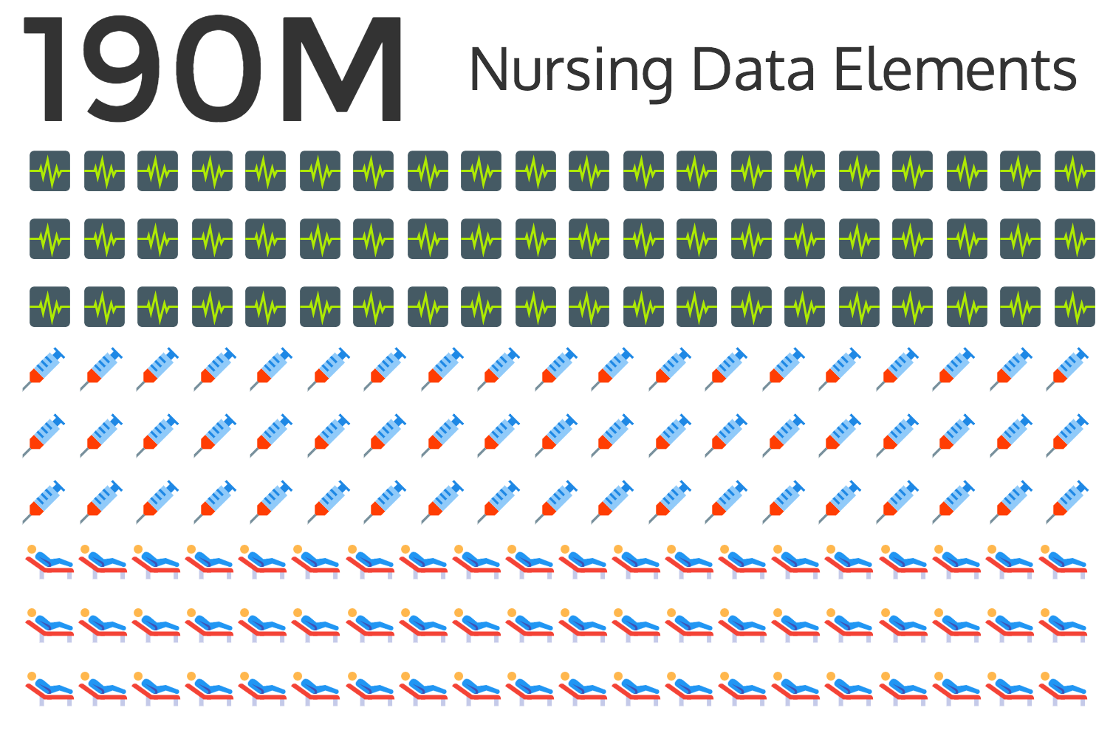

Slide 9
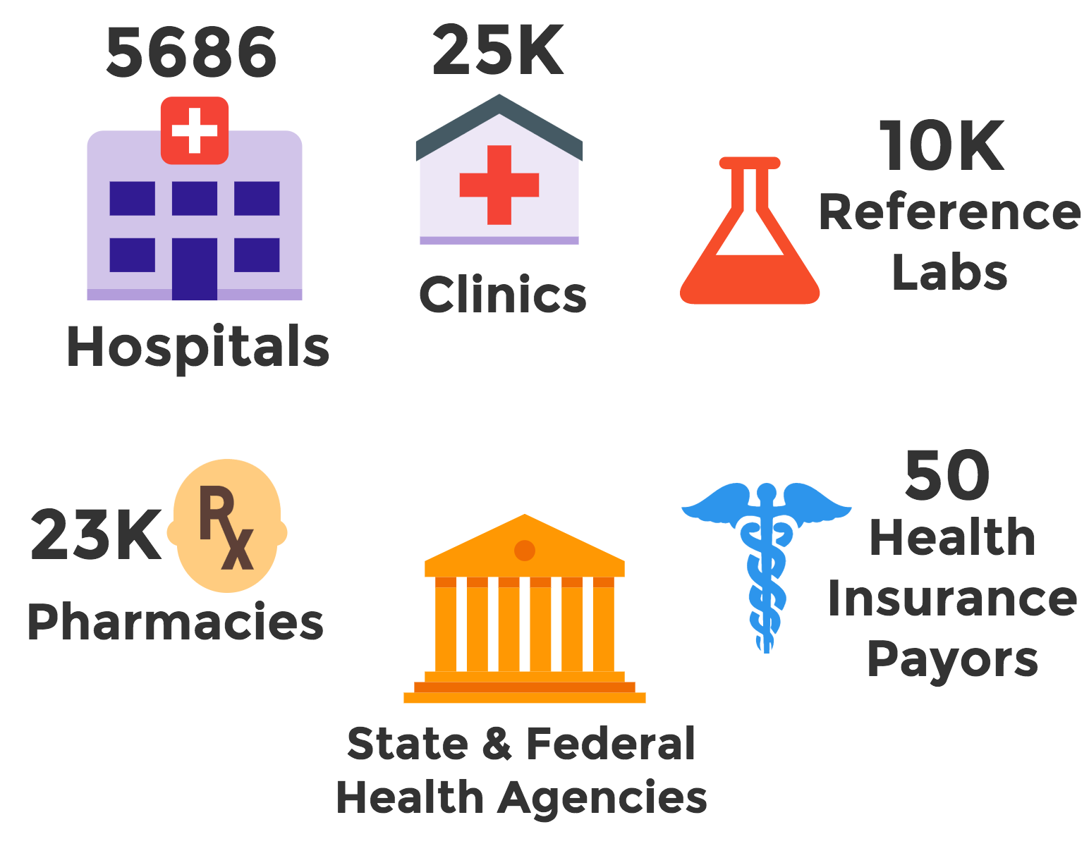
Notes:
http://www.naic.org/state_report_cards/report_card_wa.pdf
http://www.aha.org/research/rc/stat-studies/fast-facts.shtml
http://www.ncpanet.org/home/introducing-ncpa
http://www.cdc.gov/nchs/fastats/nursing-home-care.htm (number of nursing homes 15K)

Slide 10

Health Information Exchange
FAX

Slide 11
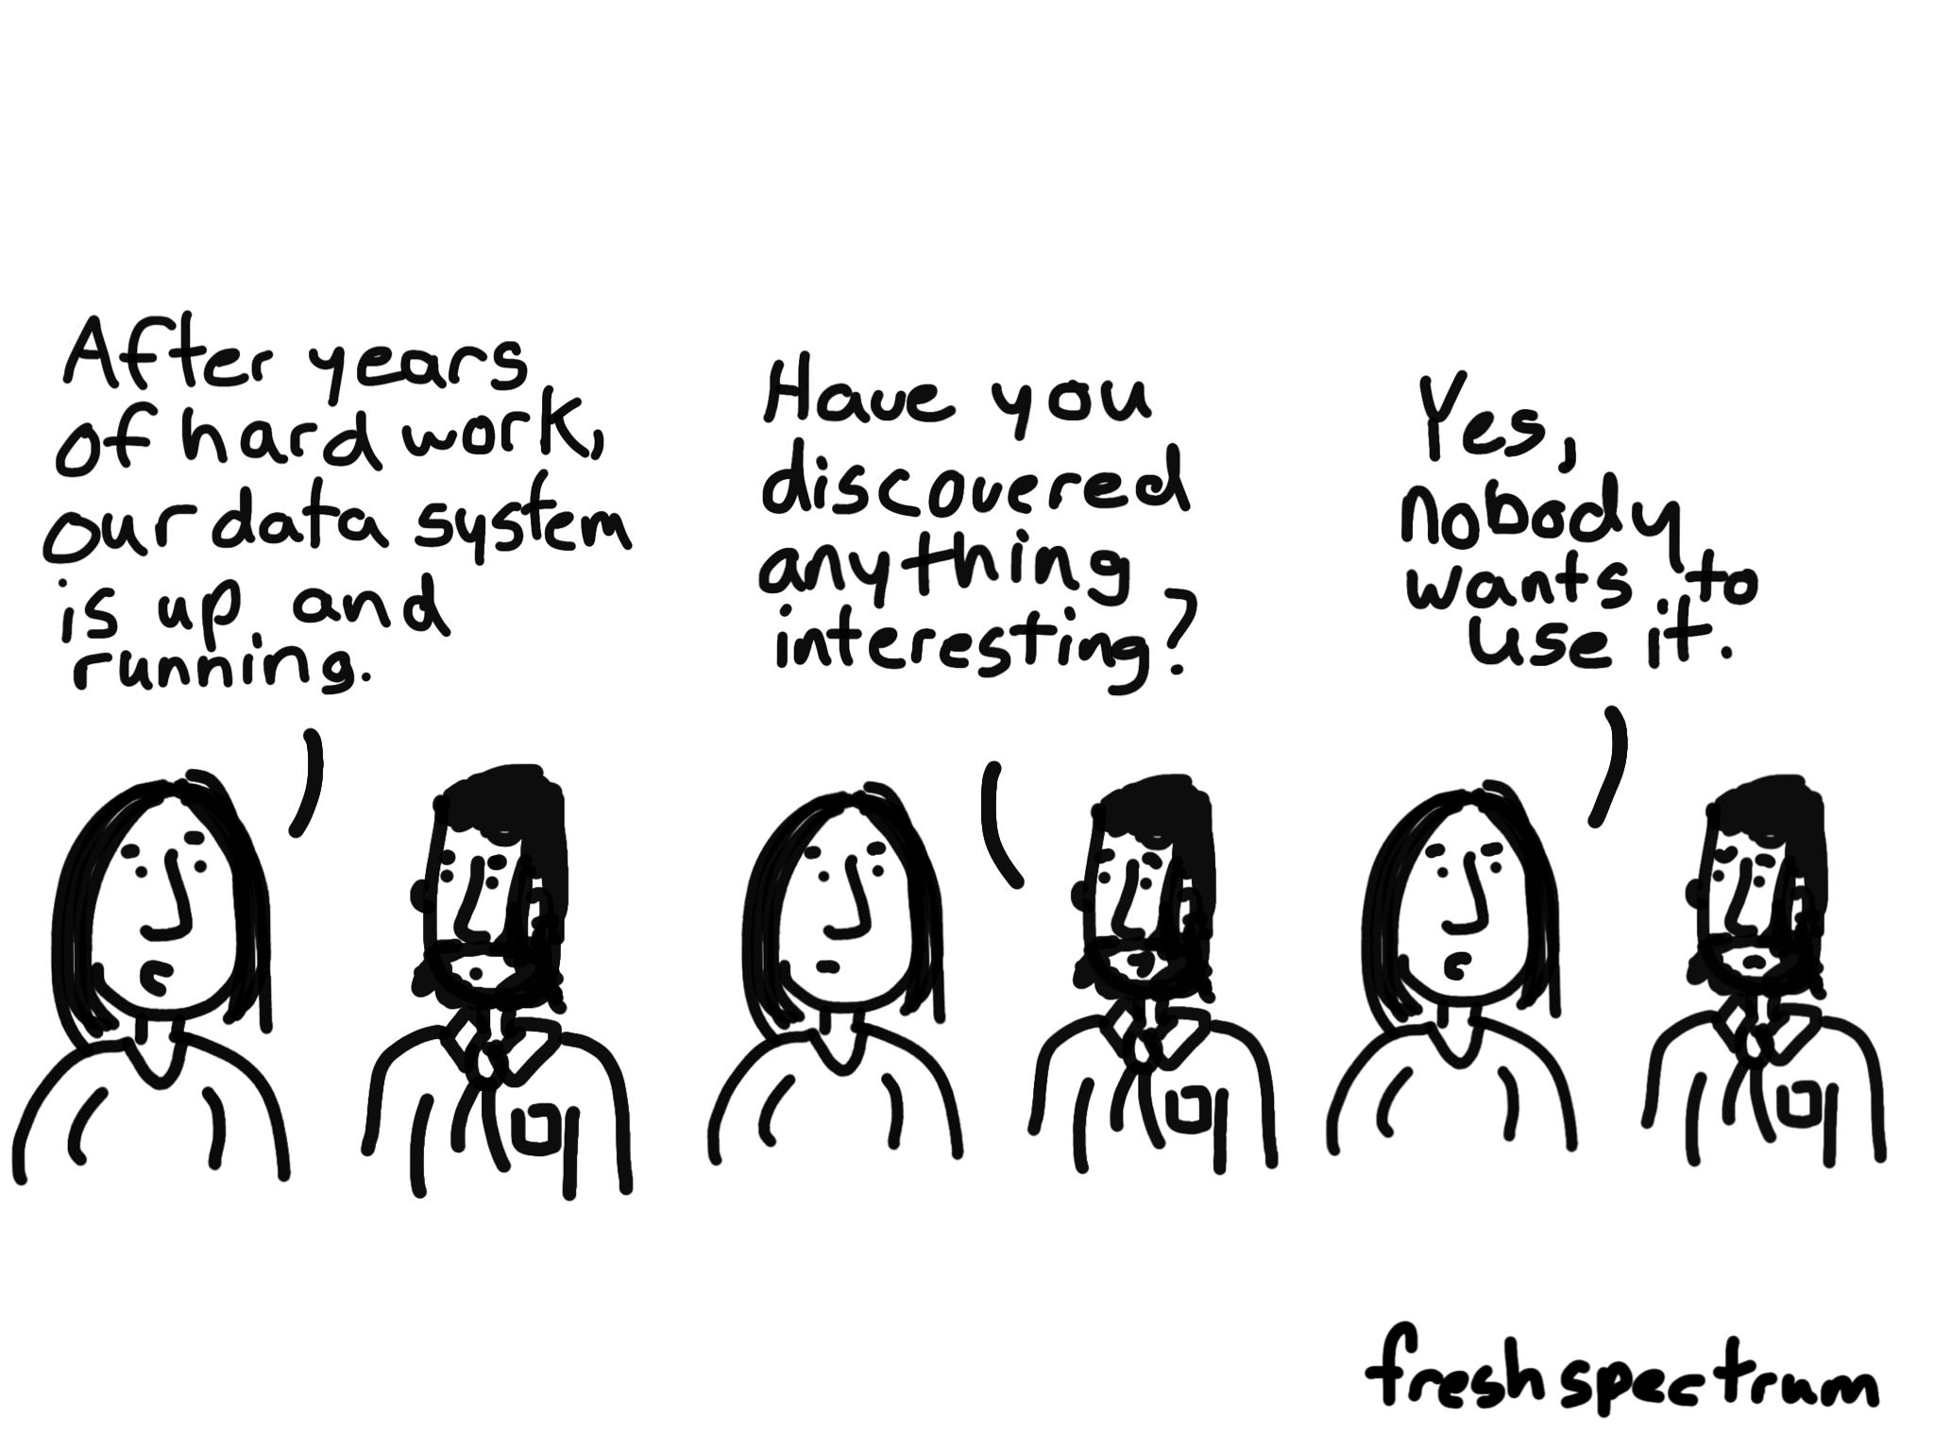
Opportunities and Risks for Secondary Use of EHR Data

Slide 12


Slide 13
Vanderbilt’s De-identified Synthetic Derivative of EHR Linked to Germ line DNA biobank (BioVU) and pathology tissue library
2.5 M Number of patient records accessible
in Synthetic Derivative – the largest database of its kind
Patient Records
211,000 Number of clinical records that have matching genetic data (75k already genotyped)
Genetic Data
27K Breast Cancer ICD code
6.6K Tumor Registry Data
4K germ line DNA samples
5.7K tumor specimens
Advantages
of
BioVU
Longitudinal Data
10 years
Average length of clinical data for patients in BioVU
Amount Invested
>$12 M Investment to create BioVU over the last 10 years
180 Peer-reviewed publications in the last 7 years from VUMC researchers creating / validating methodologies
Novel Methods
Jill Pulley
Notes:
206,282 individuals in an EHR DNA Biobank (BioVU)
Mean follow-up – 6.3 yrs
ICD9 codes – 22 million (7 million distinct patient codes)
Labs – 141 million
Distinct labs – 6426
Avg labs/patient – 684
Drugs – 159 million
Notes – 32 million (average 155 notes/individual)
Radiology tests – 2.3 million

Slide 14
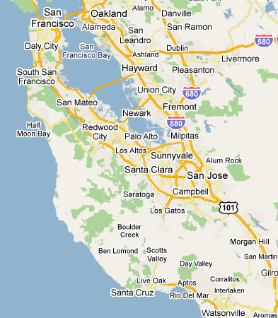


Stanford / PAMF Oncoshare Project
18,675 breast cancer patients, dx’d 2000-2014
15-20% patients shared
Integrating EMR, SEER, outside genetics lab data
20 publications
Academic, Tertiary Care
Research-Centered
Knowledge Discovery
Community-Based
Patient-Centered
Two healthcare systems serving the same population
Opportunity to study breast cancer care across healthcare settings
Allison Kurian

Slide 15
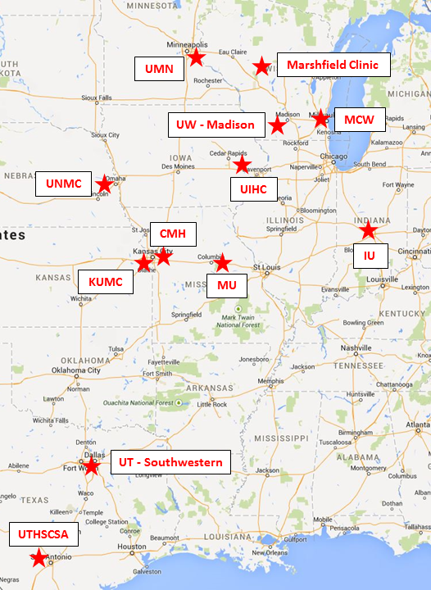
The Greater Plains Collaborative (GPC) Patient-Centered Outcomes Research Institute (PCORI)
100,000 Breast Cancer Patients
Phase I - $7M first 18 months
Phase II - $8.7M over 3 years
How can data help recruit patients to breast cancer trials with greater accuracy and timeliness?
How do we understand integrated data’s ability to provide a complete picture of care for observational studies?
University of Kansas Medical Center
Children’s Mercy Hospital, University of Missouri
University of Iowa Healthcare
Indiana University
University of Wisconsin-Madison, the Medical College of Wisconsin, and Marshfield Clinic
University of Minnesota Medical Center
University of Nebraska Medical Center
University of Texas Health Sciences Center at San Antonio
University of Texas Southwestern Medical Center
Russ Waitman, 2015

Slide 16











Many Are Looking at Different
Parts of the Same Problem

Slide 17


Slide 18

Ambiguity is the rule….not the exception
99% of patients have at least one stage phrase present in their EHR
Jeremy Warner
84% of patients have some degree of stage discordance in the EHR
Warner, Levy et al. JOP 2015

Slide 19
THERE ARE TWO KINDS OF PEOPLE:
1) THOSE THAT CAN EXTRAPOLATE FROM INCOMPLETE DATA.

Slide 20

31% surgical events missing CPT codes (outside surgeries)
94% found in other EMR sources
Ravi Atreya
Notes:
Mastectomy & Breast Conserving Surgery
Results:
We then analyzed 8966 pathology reports and oncology-related notes from the Vanderbilt EMR to determine how frequently dates of surgical events with missing CPT codes were mentioned. Of 3206 surgical events, CPT codes identified 2320 surgeries. Of the remaining 886 surgical events not covered by CPT codes, 697 (78.6%) events had their date mentioned in the pathology report or oncology-related note. As a result, 94.1% of surgical events in the cancer registry have a corresponding CPT code or mention of the surgery date in clinical text
Methodology:
To determine the feasibility of using clinical EMR data to fill in the gap of missing surgical CPT codes, we analyzed clinical text to identify the mention of mastectomy and breast conserving surgery dates. We selected all pathology reports and oncology-related clinical notes that occurred within one year of the original surgery. We searched their text for the date of the original surgical event for which the CPT code was missing. We searched the text using date formats including: MM-DD-YYYY, MM-DD-YY, MM-D-YY, M-D-YY, M-D-YYYY, MM/DD/YYYY, MM/DD/YY, MM/D/YY, M/D/YY, M/D/YYYY, Month DD, YYYY, Month D, YYYY, Mth DD, YYYY, Mth D, YYYY, Month DD, Month D, Mth DD, and Mth D (where Month and Mth are the month name and abbreviation).

Slide 21
Complex Cancer Treatment Pathways
Ravi Atreya
Notes:
Data based on 2000 to 2012 from tumor registry

Slide 22
Use Cases for Big Data in Cancer Medicine
Quality Reporting
Process Improvement
Clinical Decision Support
Discovery

Slide 23





Growing pressure on cancer centers to monitor the quality of care
Notes:
This greater focus on quality of care has placed a growing amount of pressure on cancer centers to continuously monitor the quality of care.
Growing number of breast cancer centers leading to more breast cancer accreditation orgs to

Slide 24
Growing pressure on cancer centers to monitor the quality of care
Manual Review
Complex Data Standards
Burdensome Reporting Requirements
Infrequent & Delayed Reporting
Notes:
This greater focus on quality of care has placed a growing amount of pressure on cancer centers to continuously monitor the quality of care

Slide 25
The Rate of Mastectomy has Increased
3341 Stage 0-III Breast Cancer patients,
Vanderbilt University Medical Center, 2000-2014
Ravi Atreya
Notes:
Based on 3341 Stage 0-III breast cancer patients that had a breast surgery (out of a total of 3358 stage 0-III breast cancer patients)
Data based on FY2000 to FY2014 (FY = Oct to Sept) from tumor registry

Slide 26
The Rate of Re-Excision has Decreased
2060 Stage 0-III Breast Conserving Surgeries,
Vanderbilt University Medical Center, 2000-2014
Ravi Atreya
Notes:
Based on 2060 stage 0-III breast cancer patients that started their course of care with a breast conserving surgery (out of a total of 3358 stage 0-III breast cancer patients)
Data based on FY2000 to FY2014 (FY = Oct to Sept) from tumor registry

Slide 27
26% Require Further Surgery after a Breast Conserving Surgery
24%
17%
BCS
9%
804
Stage 0-III Breast Conserving Surgeries
(BCS)
FY10-14
74% do not require
additional surgery
Ravi Atreya
Notes:
Based on 804 stage 0-III breast cancer patients
Data based on FY2010 to FY2014 (FY = Oct to Sept) from tumor registry

Slide 28
There are Many Options for Reconstruction Post-Mastectomy
Hypothesis: Data-driven shared decision making can help breast cancer patients understand their surgical options
61%
66%
33%
39%
15%
6%
74%
34%
67%
Ravi Atreya
78%
Notes:
Based on 842 stage 0-III breast cancer patients that had a mastectomy
Data based on FY2009 to FY2014 (FY = Oct to Sept) from tumor registry & CPT codes
CPT codes indicate what type of reconstruction took place (tissue expansion vs. flap type)
Color coded where unilateral is pink/on top & bilateral is maroon/on bottom

Slide 29

Practice Patterns
Citron,
2003
Proportion of patients receiving
adjuvant chemotherapy regimen per year
Sparano,
2008
Haresh Bhatia
Jones,
2006
Bhatia, Levy, AMIA 2011

Slide 30

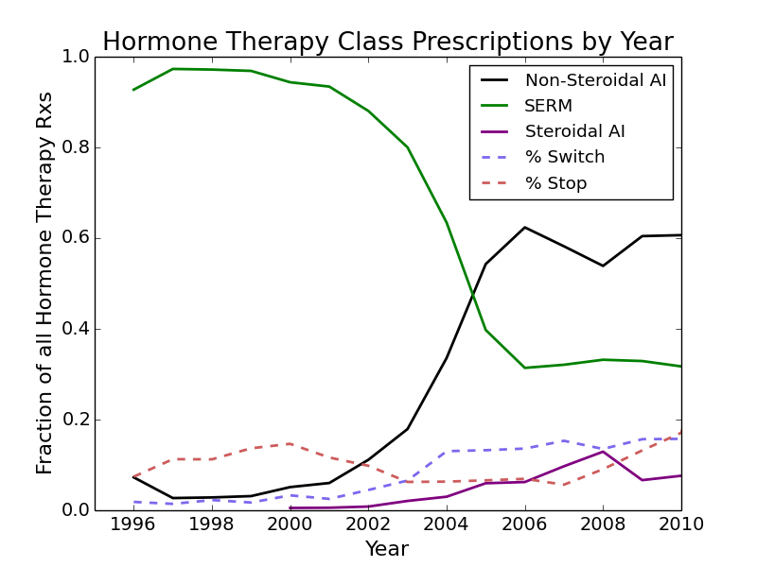
Adjuvant Endocrine Therapy
Practice Pattern Changes
Morgan Harrell
Tamoxifen 1977
Letrozole
Exemestane
2005
Anastrazole
2000

Slide 31
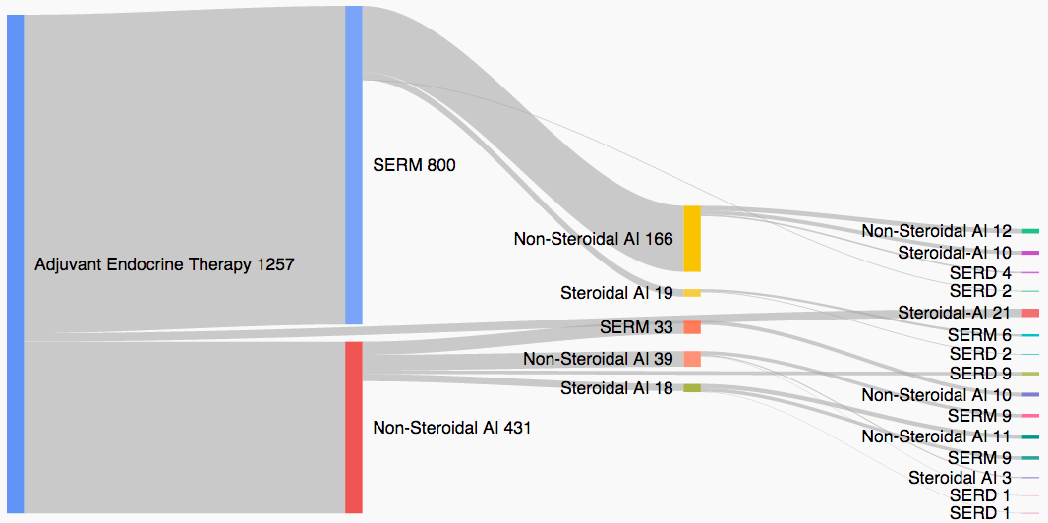
Adjuvant hormone therapy drug switching patterns
30% did NOT complete 5 years of adjuvant therapy
25% switch drugs
50% who switch complete 5 years
Morgan Harrell

Slide 32
Process Improvement

Slide 33
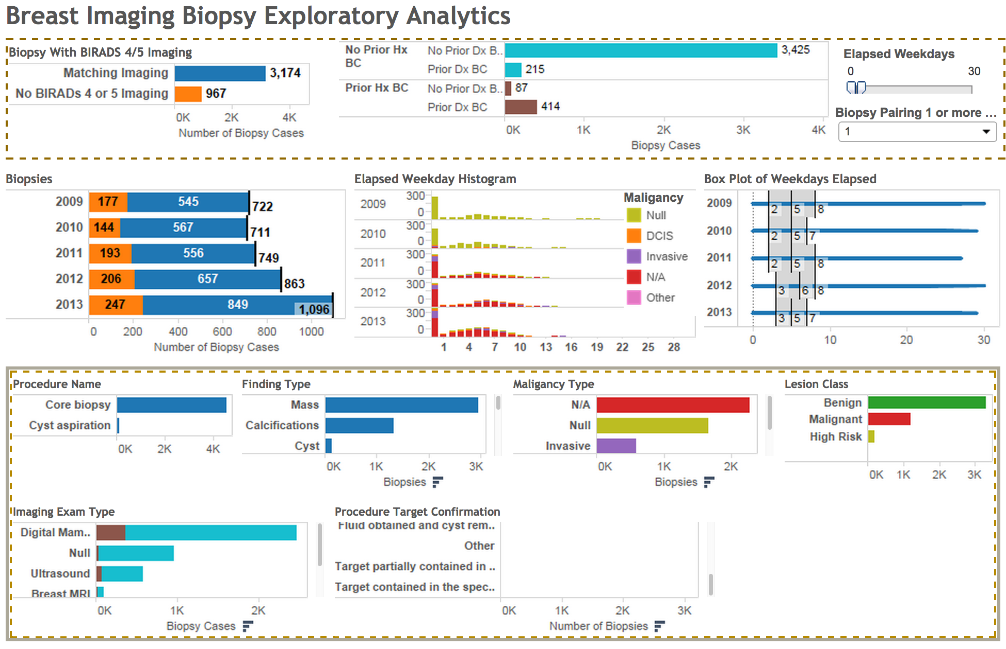
Breast Biopsy Analytics Dashboard
Levy, 2014

Slide 34
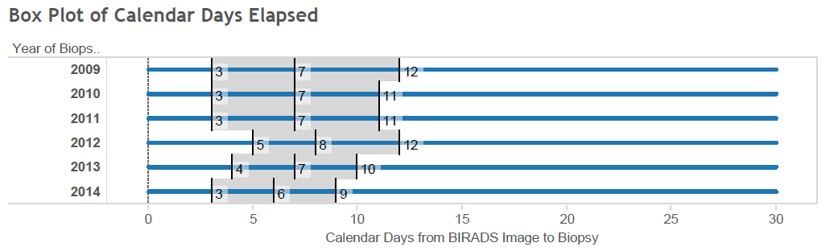
Boxplot of Days Between BIRADS 4/5 Imaging Study and Biopsy
Levy, 2014

Slide 35
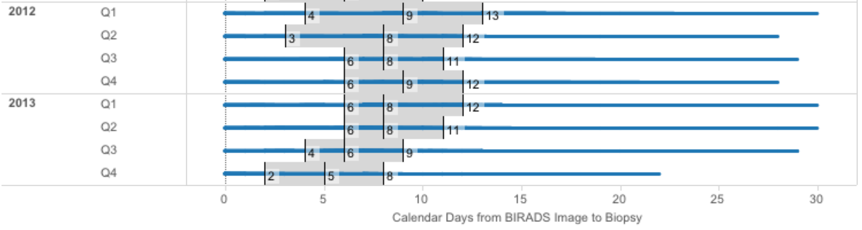
Boxplot of Days Between BIRADS 4/5 Imaging Study and Biopsy
Intervention
Levy, 2014

Slide 36
Pragmatic Trials Driven By EMR

Slide 37
Chlorhexidine – Example
Cluster-randomized cross-over design.
5 Vanderbilt ICU (clusters) randomized for 1 year.
9,340 patients randomized to:
  Chlorhexidine
  Control group
Low cost
Used only the Vanderbilt Electronic Medical Record for data collection.
Funded by VICTR
Bernard, 2015

Slide 38
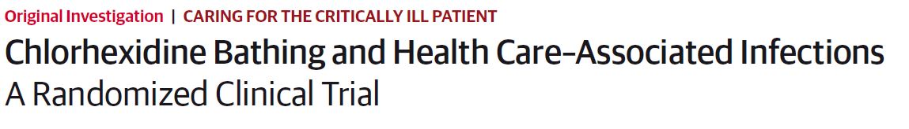
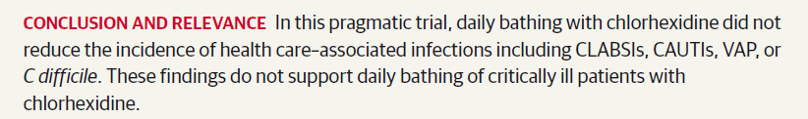
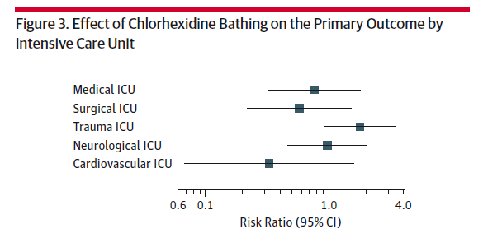

This can save Vanderbilt $500,000 per year
Bernard, 2015

Slide 39
Evolution of Clinical Decision Support
Evidence Driven
Protocol Driven
Pathway Driven
Data Driven?

Slide 40
Thank you
mia.levy@vanderbilt.edu

Slide 41
Federated Knowledge Base
Federated Data Archive
ID/de-ID
Discovery
Site 1..x
Predictive algorithms
Alert/notification rules
Order sets
Care pathways
Documentation Templates
Translation
Site 1..x
Implementation
Site 1..x

Slide 42

Information Blocking
September 15, 2015

