Slide 1
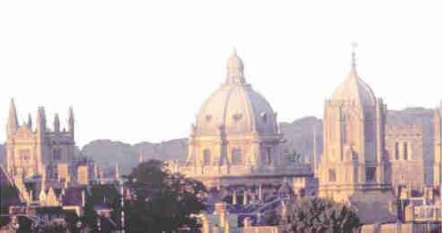

BD4BC: an image analysis perspective
Sir Michael Brady FRS FREng FMedSci
Professor of Oncological Imaging
Department of Oncology
University of Oxford

Slide 2
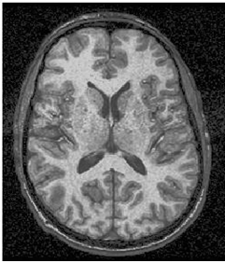
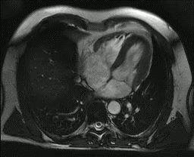
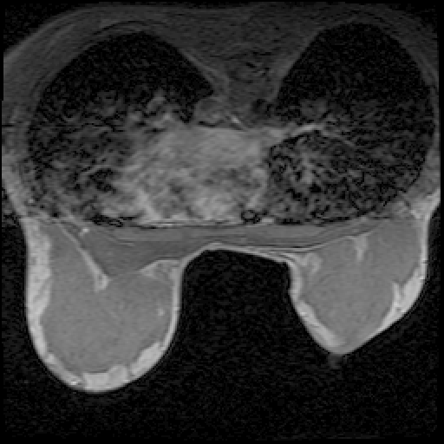
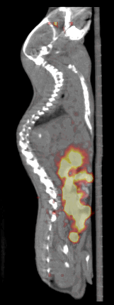
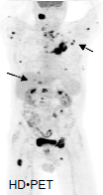
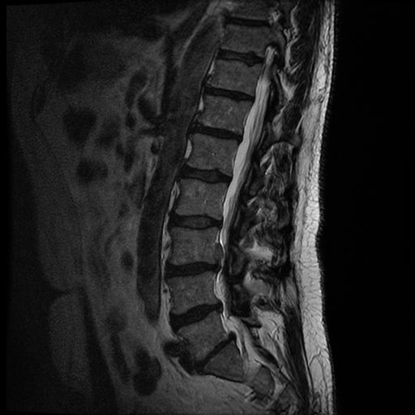
A day in the life of a clinician

Slide 3
BD4BC: an Image Analysis Perspective
“Huge” databases can be collected easily
  Internet (2.0), Cloud processing
  Statistical power, e.g. 4M mammos p/y
  75M mammos p/y rising to 150M within 10 years
Substantial developments in machine learning
  Random Forests, Deep Learning, …
  Model driven (conventional stats) → Data driven → priors + big data
Marginalise confounds
  How might we learn to recognise an automobile??
  Given 100 examples, rely upon a model… that is, tell the program the answer

Slide 4
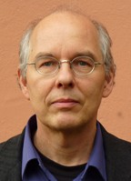
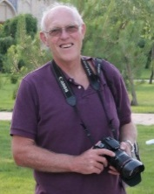

Example 1/4: Pattern Learning & Recognition
Deep learning for Computer-Aided Detection of Mammo Lesions
Deep learning applied to 250X250 patches of 45,000 mammograms
What could we learn from a training set of 25,000,000 mammograms that is beyond 45,000??
What could we learn from 100,000 Mammo+ABUS/MRI???

Slide 5
Example 1/4: Pattern Learning & Recognition
Large scale deep learning for CAD Mammo Lesions
Prediction of likely masking and Interval cancers
  1/3 interval cancers in UK were “predictable” on previous mammo

Slide 6
Masking risk: Carla van Gils
VDG Density | Screen detected breast cancer |  |  | Interval breast cancer
 | OR_{unadjusted} | 95% CI |  | OR_{unadjusted} | 95% CI
1 | 1 | (ref) |  | 1 | (ref)
2 | 1.61* | 1.19 | 2.19 | 2.38* | 1.17 | 4.86
3 | 1.64* | 1.20 | 2.26 | 4.77*¥ | 2.38 | 9.57
4 | 1.49 | 0.97 | 2.29 | 5.93*¥ | 2.74 | 12.82
 | OR_{age adjusted} | 95% CI |  | OR_{age adjusted} | 95% CI
1 | 1 | (ref) |  | 1 | (ref)
2 | 1.65* | 1.21 | 2.24 | 2.45* | 1.20 | 4.99
3 | 1.78* | 1.29 | 2.47 | 5.24*¥ | 2.59 | 10.59
4 | 1.69* | 1.08 | 2.63 | 6.86*¥ | 3.12 | 15.11
VBD (per SD increase)^{X} | OR | 95% CI |  | OR | 95% CI
OR_{unadjusted} | 1.11* | 1.02 | 1.22 | 1.51* | 1.31 | 1.75
OR_{age adjusted} | 1.17* | 1.06 | 1.29 | 1.58* | 1.36 | 1.84
*P<0.05, Screen detected as reference category: ¥P<0.05

Slide 7
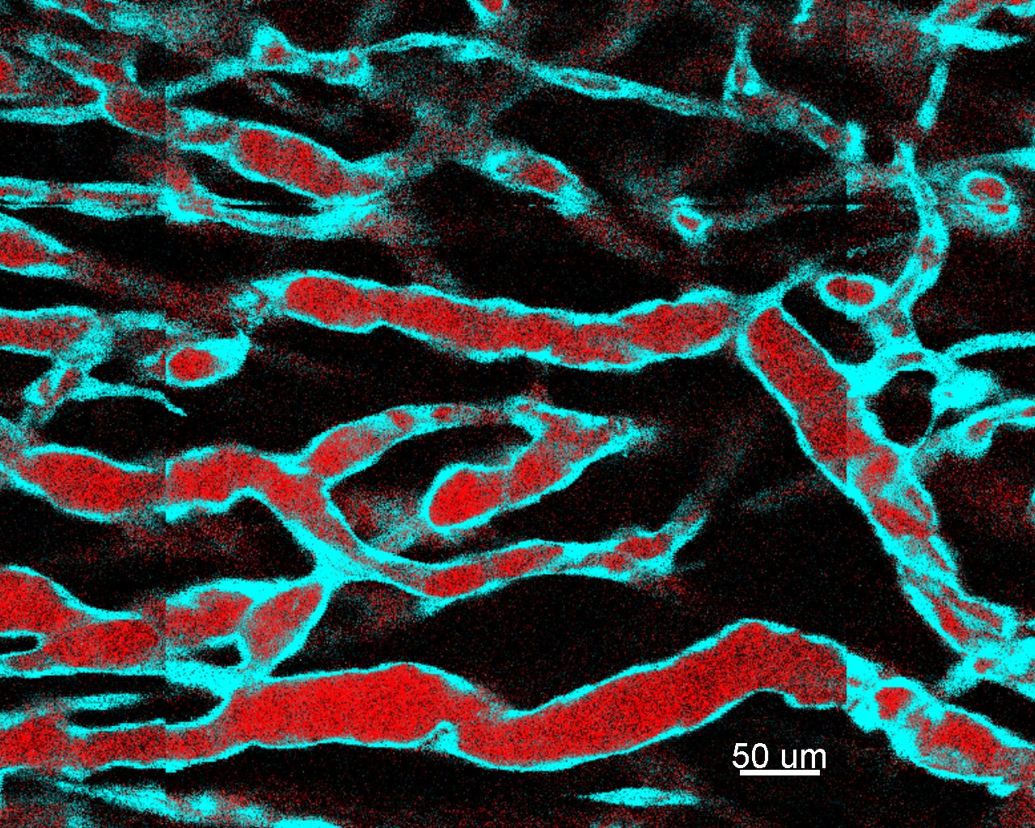
Example 1/4: Pattern Learning & Recognition
Large scale deep learning for CAD Mammo Lesions
Prediction of likely masking and Interval cancers
  1/3 interval cancers in UK were “predictable” on previous mammo
Digital Pathology: abnormalities
Angiogenesis: tumor vascular growth dynamics
  Up to 10 serial image volumes, 6 hours apart
  10 3D volumes with 1μ sampling
  Brings a network of meaty PCs to its knees
  Math model that (sh!!!) links to real data?
2 phase microscopy

Slide 8
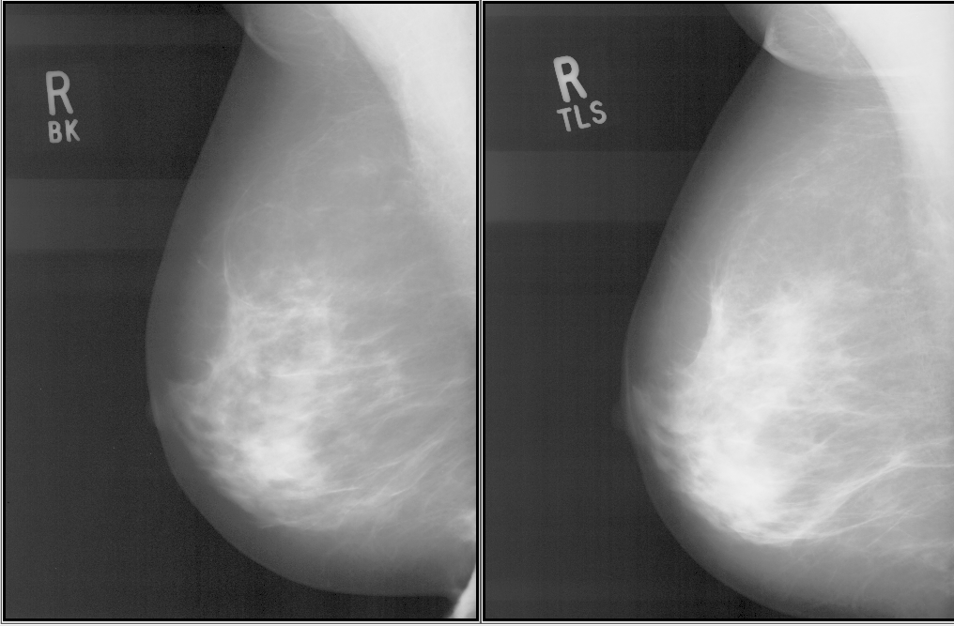
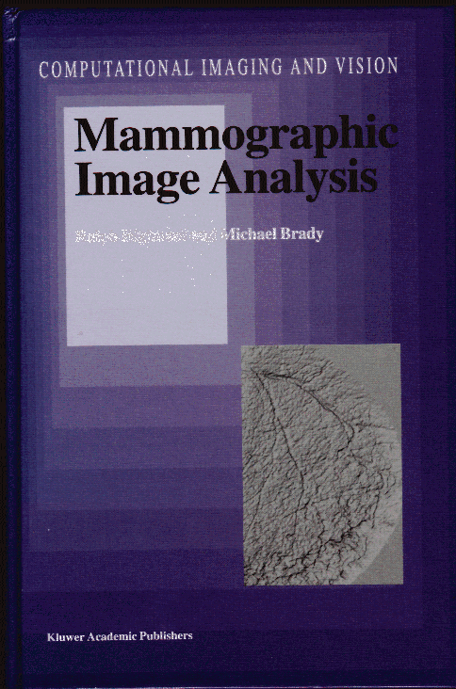
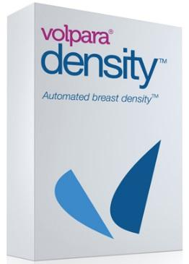
A fundamental problem …
1998 to 2014
Two of the UK’s most experienced breast radiologists each examined the two mammograms shown, to estimate the percentage of dense tissue.
BK estimated 25%; TLS estimated 40% …. but it is the same breast!!!
Unsurprising that inter/intra radiologist agreement is only 30%...
But what is the source of the problem??

Slide 9
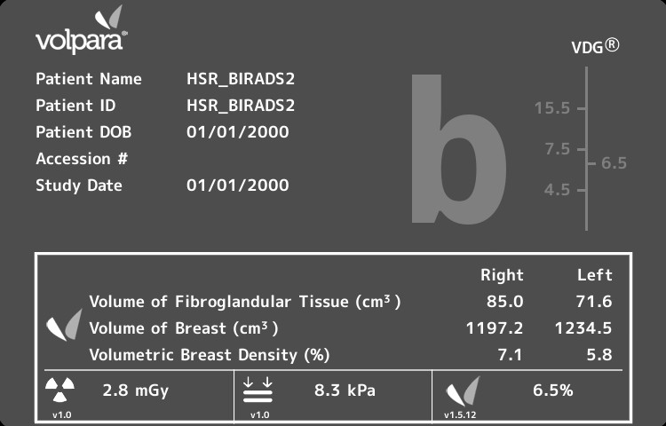
Example 2/4: Involution & BC risk
Quantitative measure of amount of dense tissue in a mammo
At this pixel, 5.8cm of fat; 0.2cm of dense tissue
At this one, 3.6cm fat, 2.4cm of dense tissue
4,000,000 mammograms processed in last 12 months
FDA cleared
Hundreds of installations in 33 countries

Slide 10
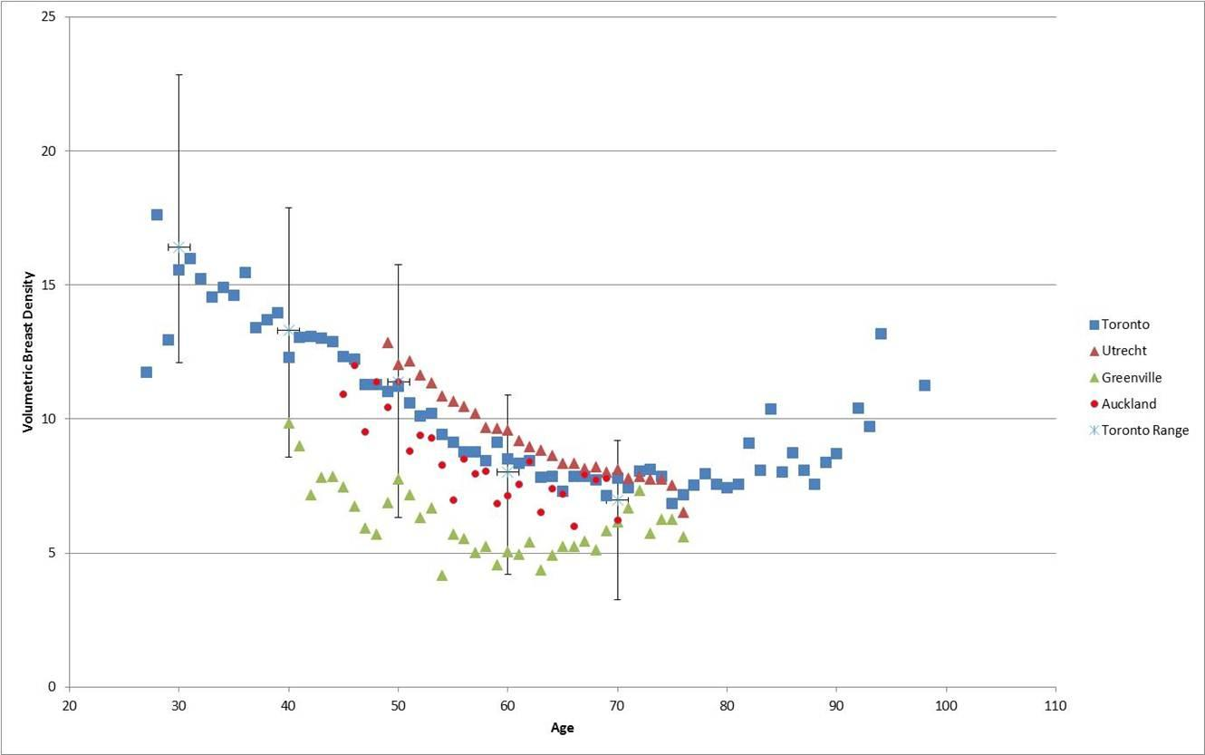
Example 2/4: Involution & BC risk
Quantitative measure of amount of dense tissue in a mammo
Comparative study of 5 populations
Schroeder – RSNA 2011: “At What Age Should Screening Begin?”
The Greenville screening population has significantly less dense breasts (and significantly larger)
Yet, roughly the same percentages of BIRADS classes are assigned
VBD
Age

Slide 11
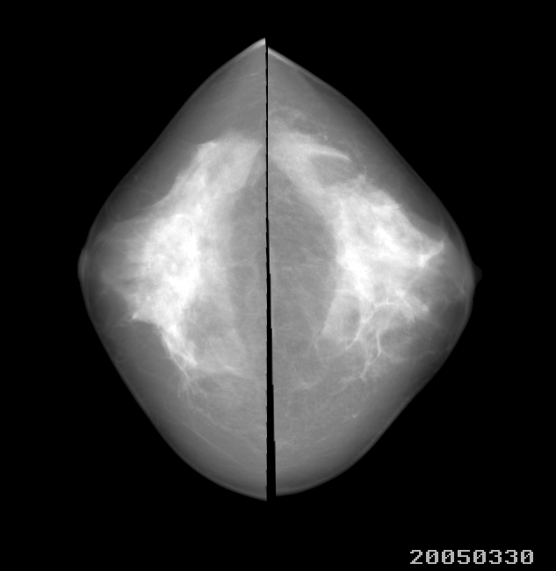
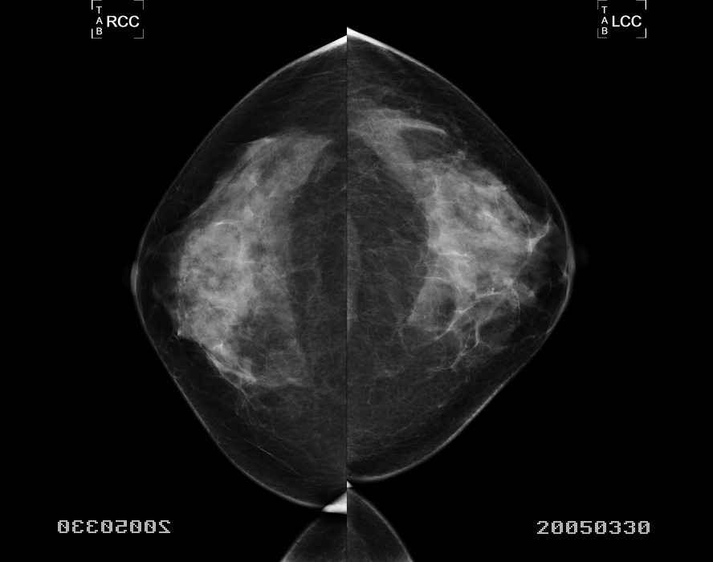
Example 2/4: Involution & BC risk
Quantitative measure of amount of dense tissue in a mammo
Comparative study of 5 populations
Tyrer-Cusick risk prediction + density map
Year|month|day

Slide 12
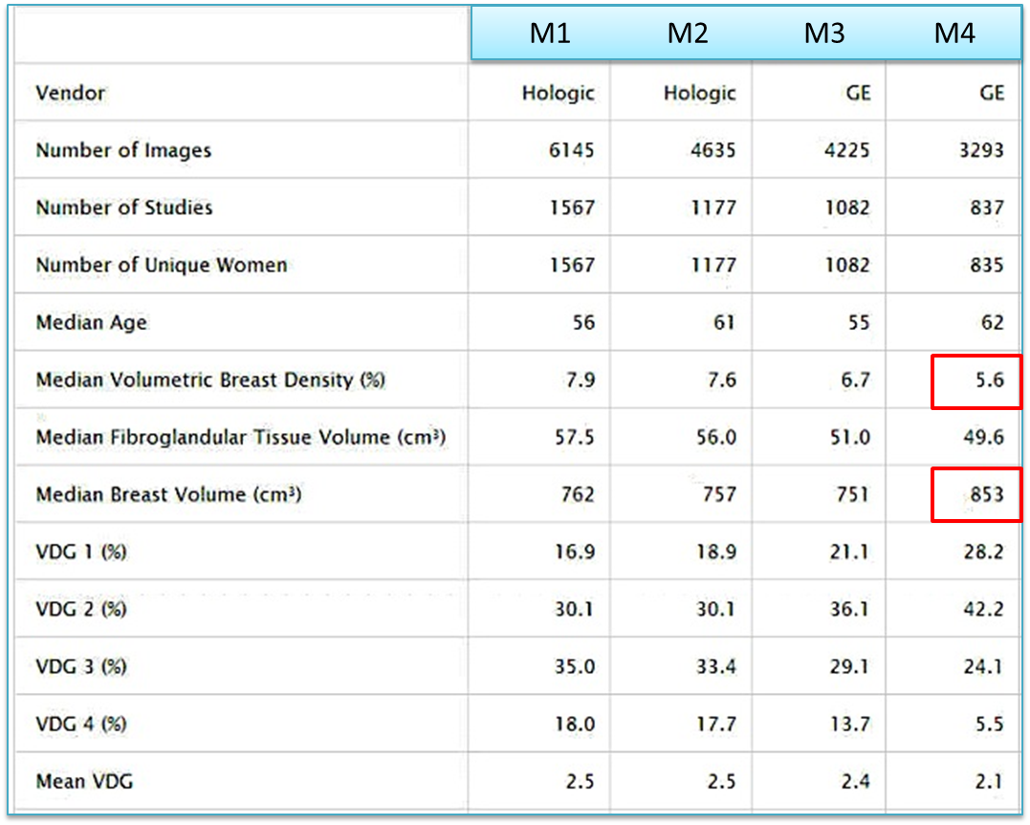
Example 3/4: Quality Assurance
Dose estimation and reporting
Pressure exerted during mammography
Breast size, fat content, …
What information might this provide about an entire breast imaging system?
There are 91 breast screening centres in the UK. All screening mammos in the Netherlands are done in vans.
Not all centres, not all vans, have consistently high quality.. Leave-one-out …

Slide 13
Example 4/4: Personalisation
A breast atlas

Slide 14
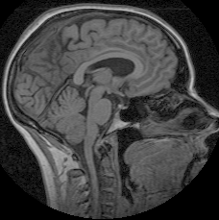
Original Data From 200 Subjects
Used to create an atlas – the “average” brain, so that differences between this brain and the average can be noted
Suppose it was 1,000,000 brains
The database of brains may comprise: young/old; male vs female; normal vs (many) diseases; left vs right handed; …
Can we dynamically create an atlas that is relevant for this patient?

Slide 15
Personalised atlas
Personalising the atlas
  “a 79 year old man who has a history of transient ischaemic attacks”
The cloud is crucial because:
  The data is federated across many sites to provide the necessary statistical power
  selection of relevant exemplars has to be computed “on demand”
  The atlas then needs to be computed on the fly from the exemplars
  To do this, the data needs to be aligned (geometrically and photometrically) and perhaps non-rigidly – a computationally intensive step

Slide 16
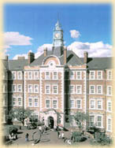
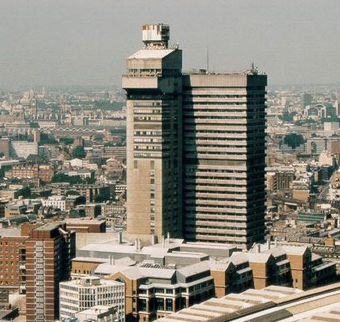


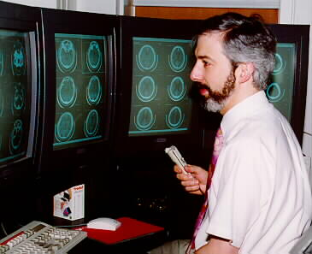

IMPERIAL
COLLEGE
Get reference images
KING’S COLLEGE
LONDON
King’s College
London
(Guy’s Campus)
Create atlas
Patient scan
+ instructions
Personalised Atlas
Oxford
University

Slide 17
Example 4/4: Personalisation
A breast atlas
CC/MLO/Tomo – MRI – ABUS
Stratification
  Which women should have an MRI/ABUS (and be reimbursed)?
  Identify region of interest on MRI/ABUS from mammo/tomo
How to optimise imaging for this patient?
  We could start from the imaging parameters used last time and an objective measure of the “quality” of that image (signal to noise, useful contrast, …)
  For fatty breasts (~BIRADS a,b), Tomo systems give significantly higher dose than mammo; roughly equal on c, d

Slide 18
Looking forward
Evidently, there is much to do!!
  EVERYTHING I have illustrated is preliminary
  EVERY example could have been MRI or PET or … as well as mammo
  Fusion of MR/CT/PET is easy, but
  Deformable registration of pathology/microscopy to radiology is completely unsolved
  The massive scale differences genomic – path – radiology unsolved
Joint research projects
  Big data projects are intrinsically multinational, but there are too few
  “One million women” → one million women & their images & …
Educate the public
Educate the regulatory bodies
…

